Slide 1


Generation SG JDE05 Interim Project
Members
Daniel, Pin Pin Yvonne, Pin Yeen Erica, Shawn
DPPS

Slide 2


Objective
Local favourite: Air tickets before and after COVID
Pursued several sources like Amadeus, Trip.com, Booking.com, Singapore Airlines, Agoda, Expedia etc.
None provided historical prices, only booking of flight and lodging

Slide 3

Further brainstorming
Another local favourite: Resale HDB
Decided on DATA.Gov.SG API/Data
Comprehensive data and 100% Singapore context

Slide 4

Problem Statement
To buy a flat at the coolest area in Singapore, at the best price

Slide 5

Data needed for analysis
Air temperature
Humidity
Resale HDB transaction prices

Slide 6
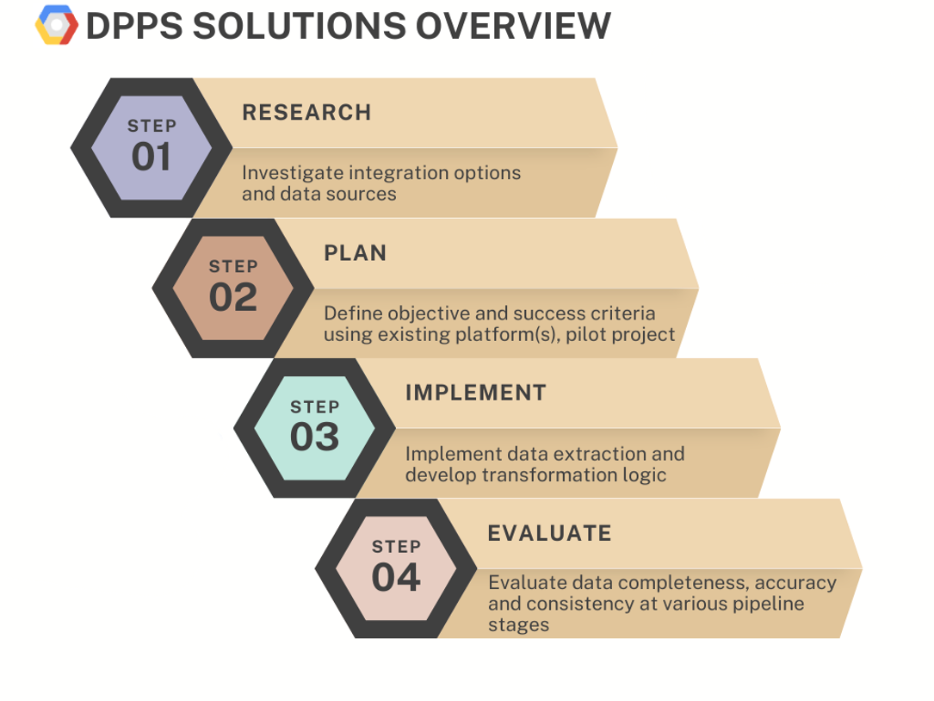


Problem solving framework

Slide 7

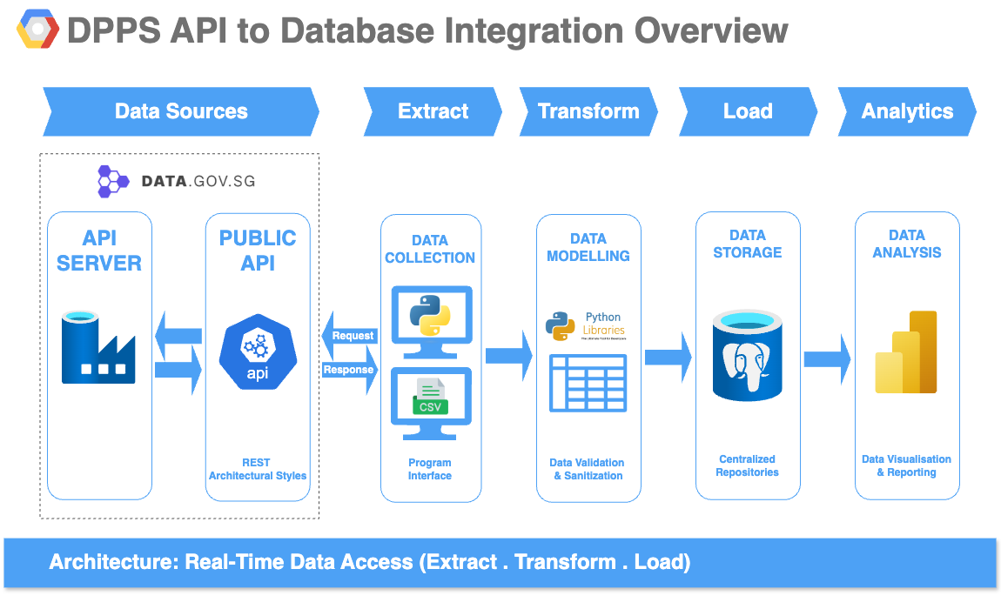

Slide 8
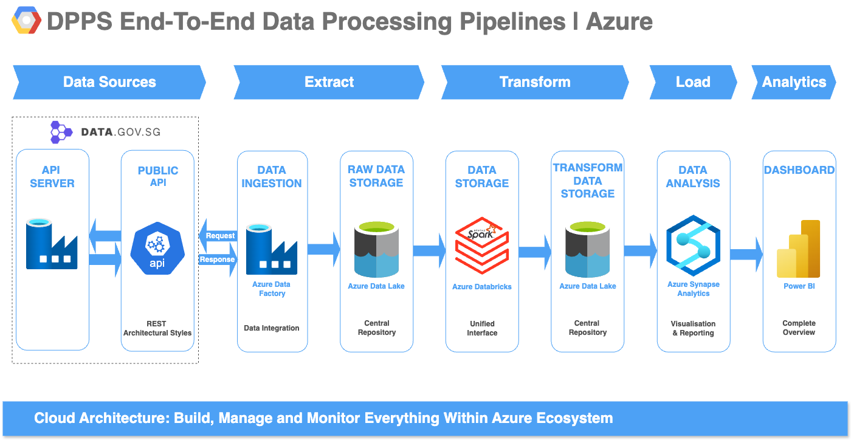

Slide 9
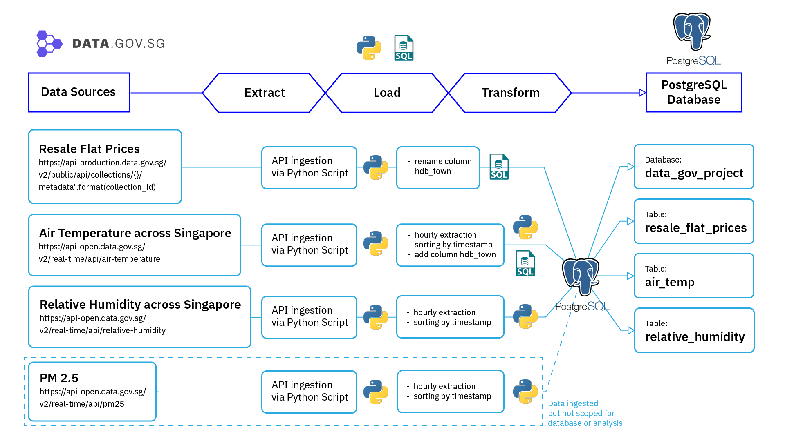

Slide 10


Extract
NEA API https://api.data.gov.sg/v1/environment/air-temperature https://api-open.data.gov.sg/v2/real-time/api/relative-humidity
HDB CSV https://api-production.data.gov.sg/v2/public/api/datasets
Air temperature readings
Humidity readings
HDB transaction prices
DATA.GOV.SG

Slide 11
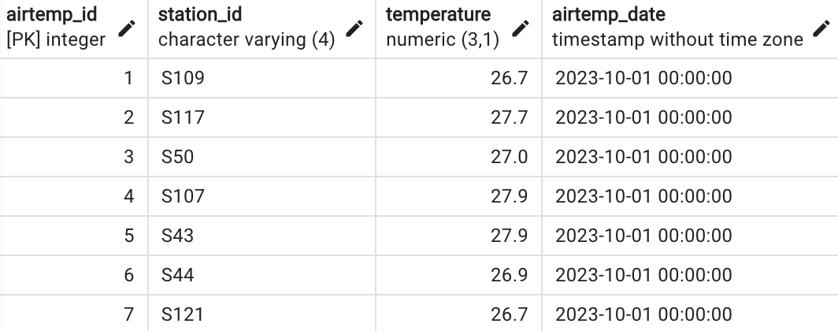
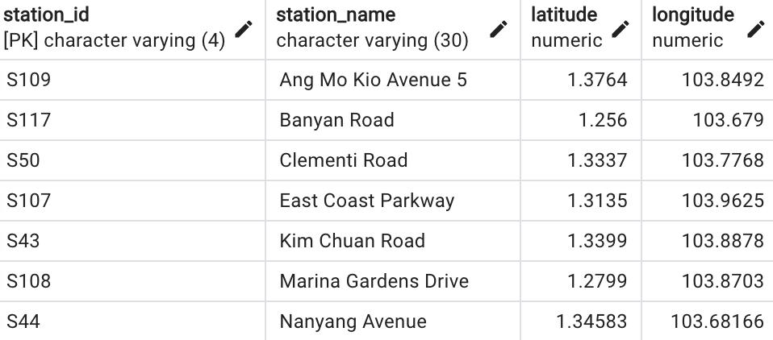
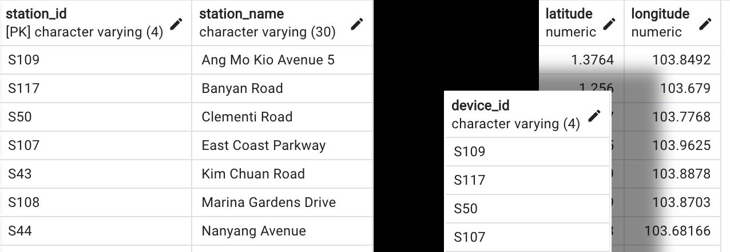
Transform
Data normalisation to reduce redundancy
Split JSON data to different data frames to remove repetition
Drop unnecessary columns
Filter out outliers or incomplete data

Slide 12
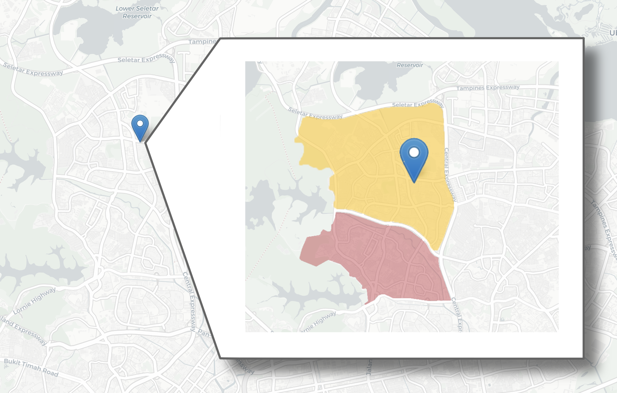

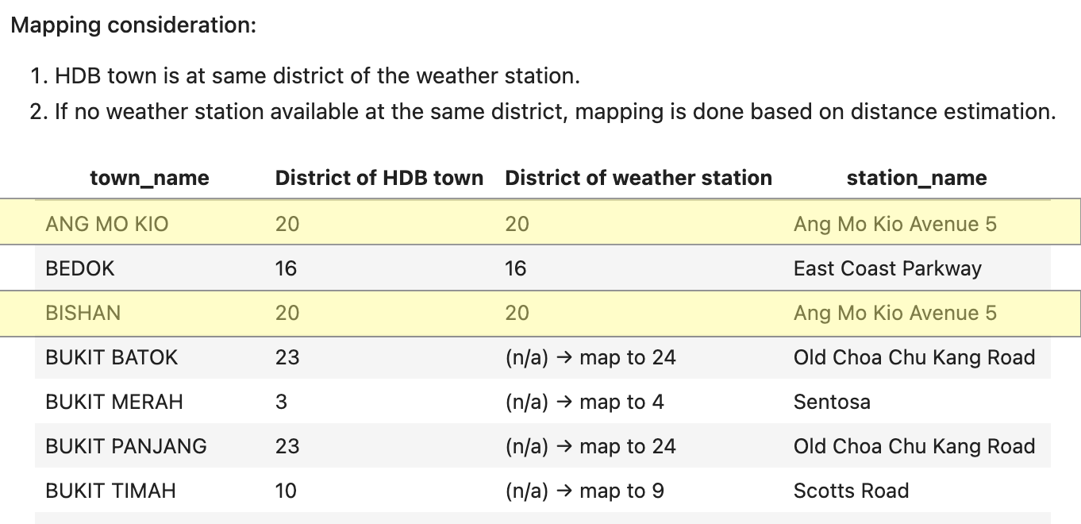
Mapping HDB towns to weather stations
Ang Mo Kio ave 5 station
Ang Mo Kio town
Bishan town

Slide 13

Load
Move data into project database
Database consists of five tables: weather station locations, humidity, air temperature, HDB resale prices, mapped HDB town-weather station
PM2.5 table is available for future analysis

Slide 14
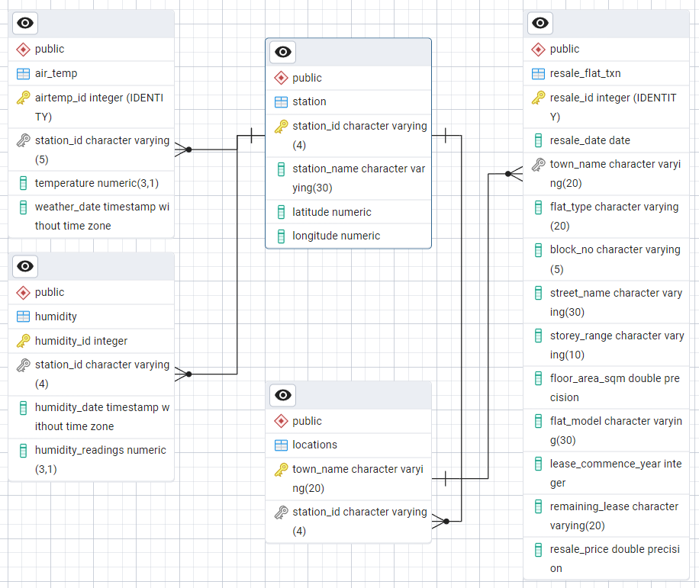
Entity Relationship Diagram
Database Model: Relational Model
Future Consideration: Dimensional Galaxy Model to further reduce dependencies and redunduncies

Slide 15
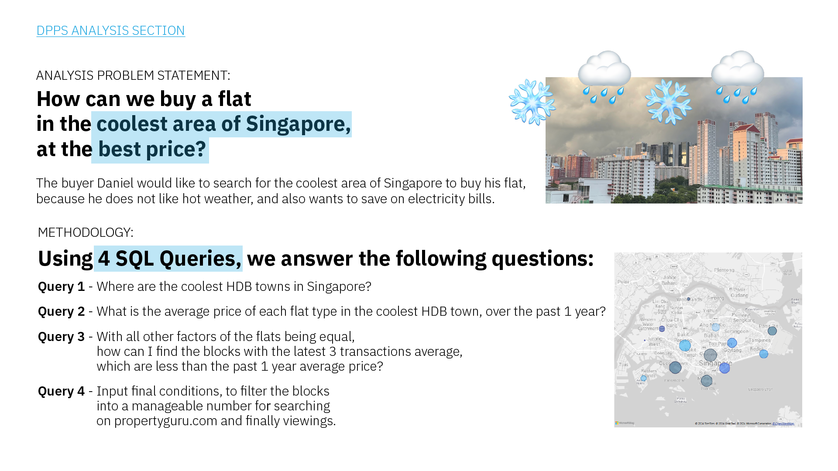


Slide 16
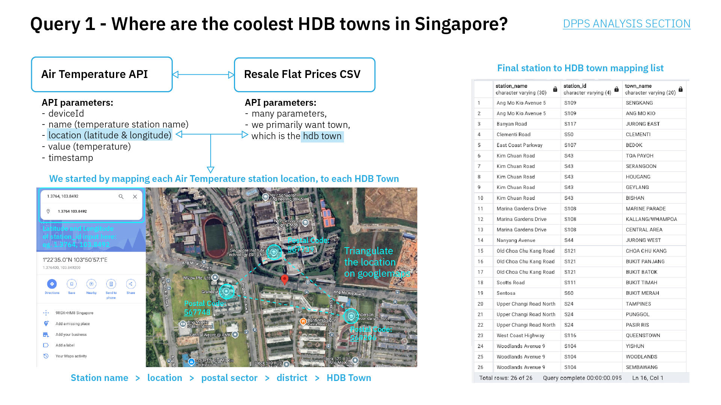

Slide 17
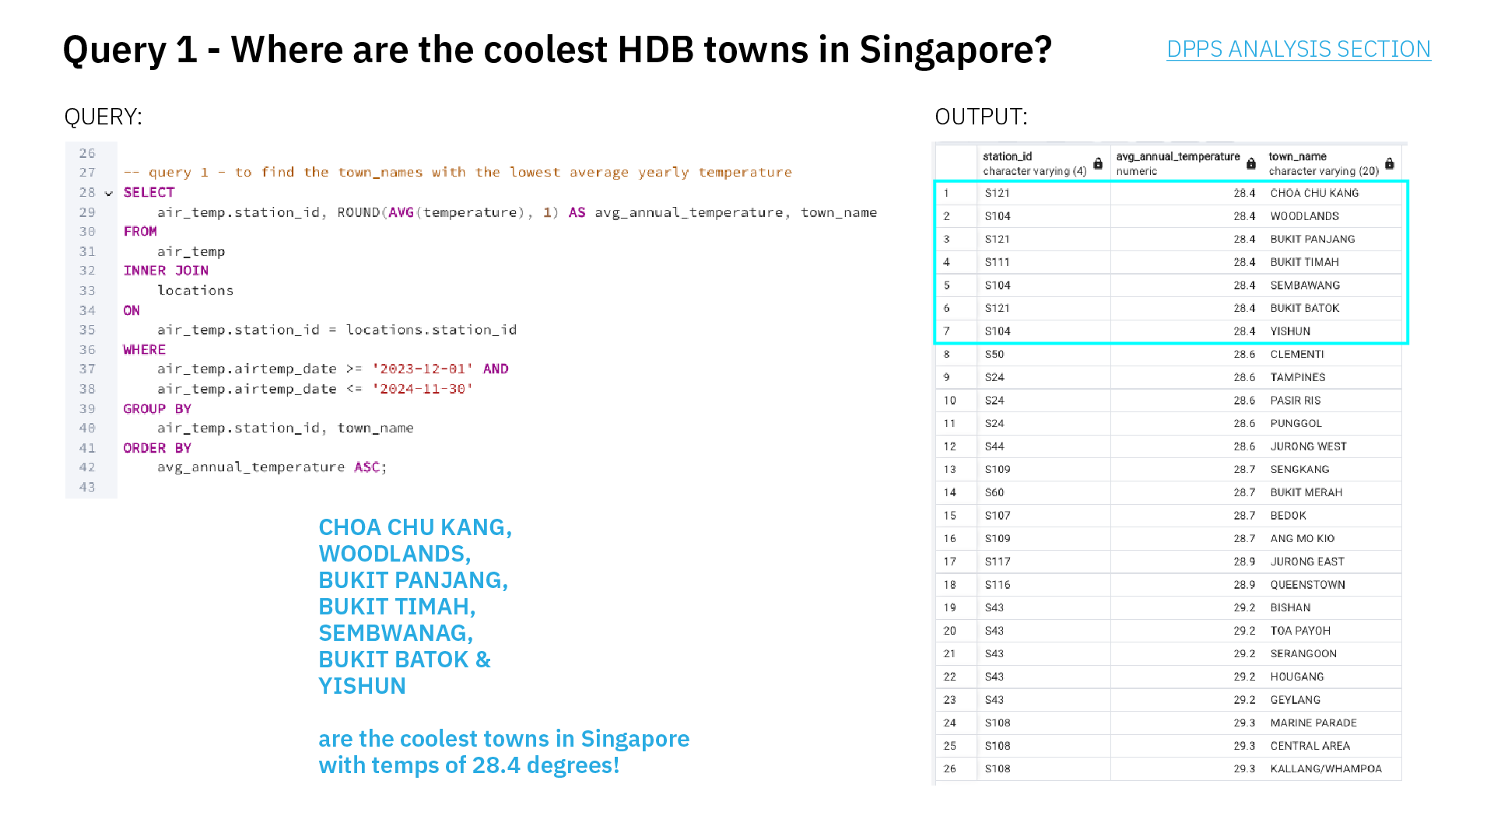

Slide 18
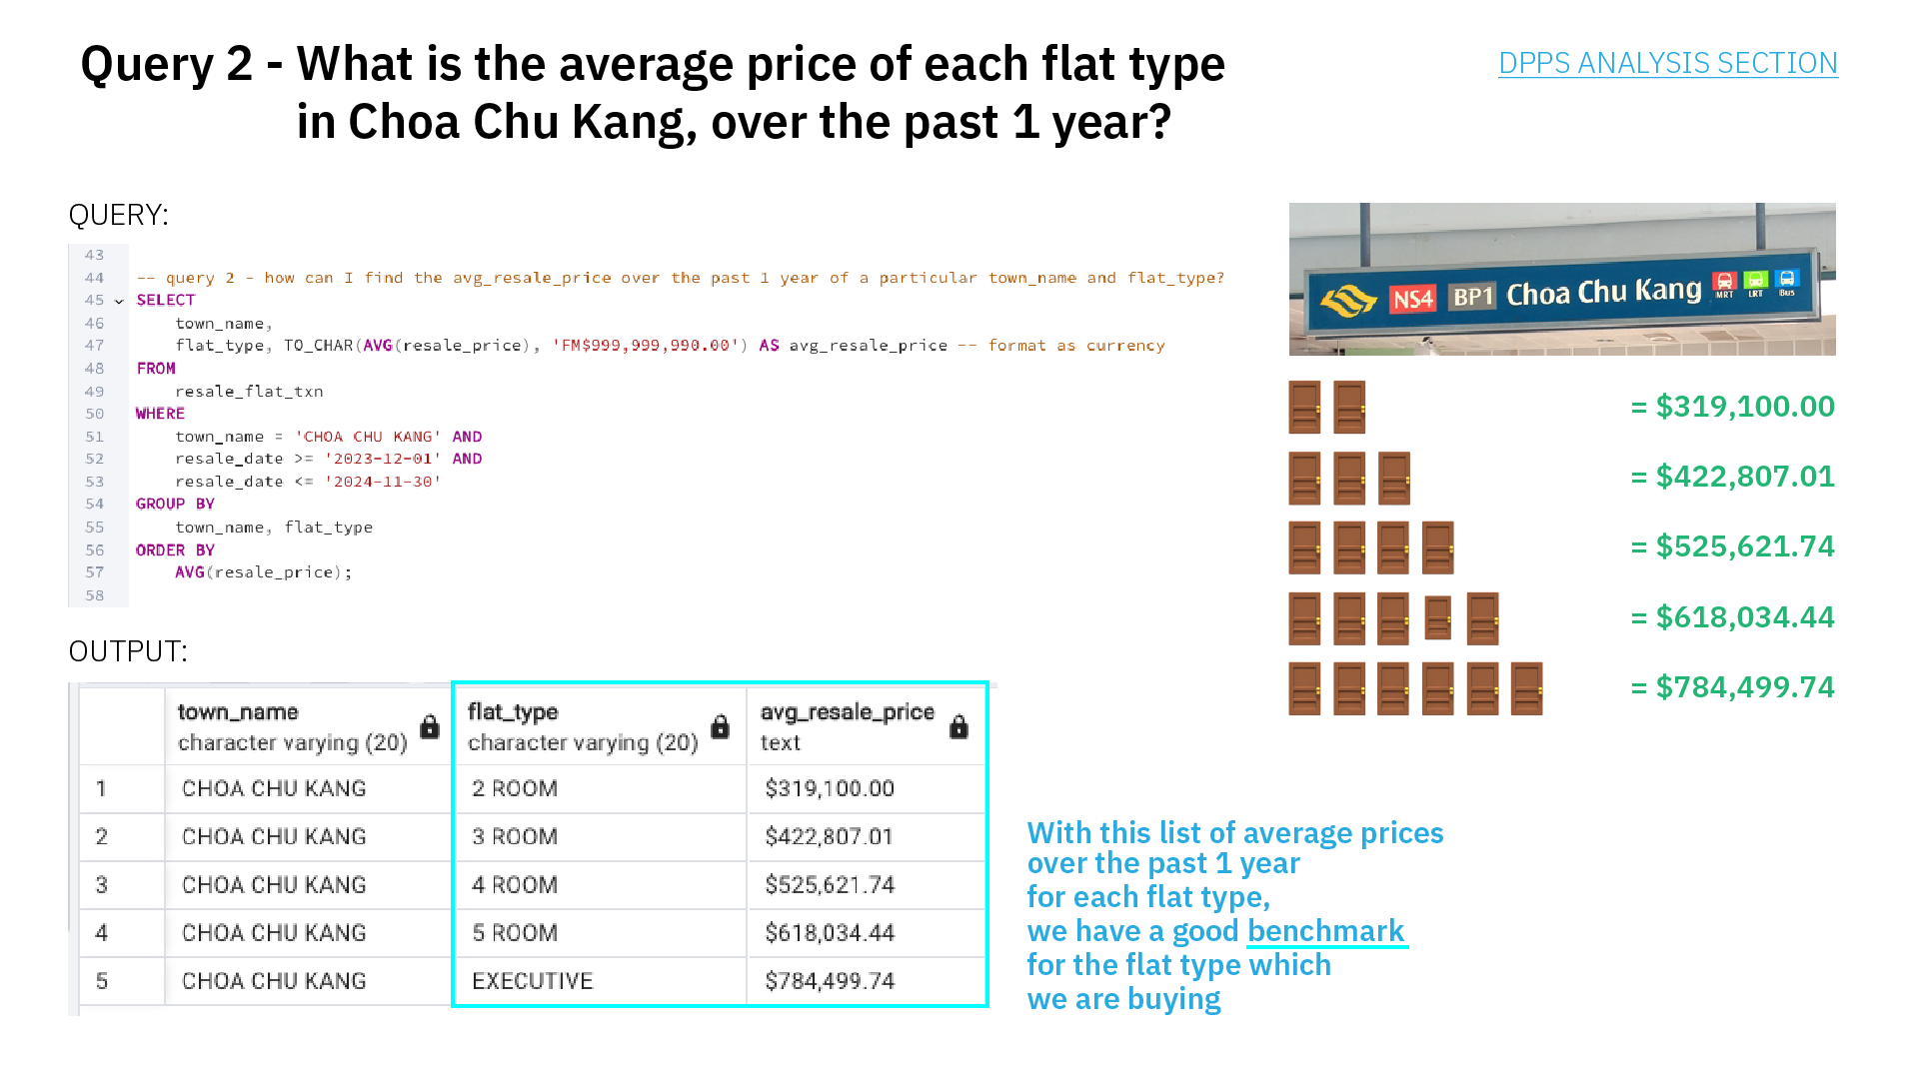

Slide 19
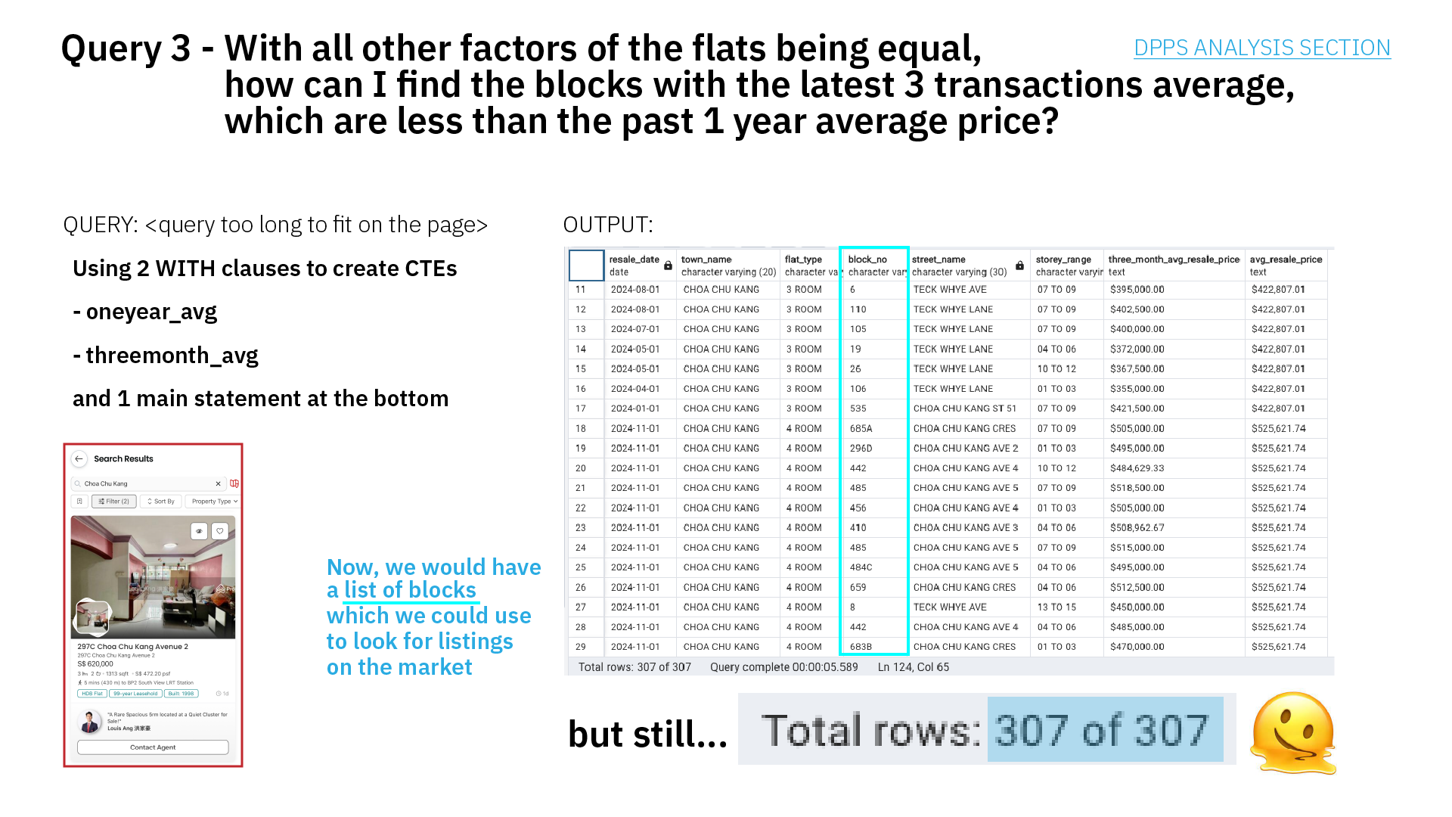

Slide 20
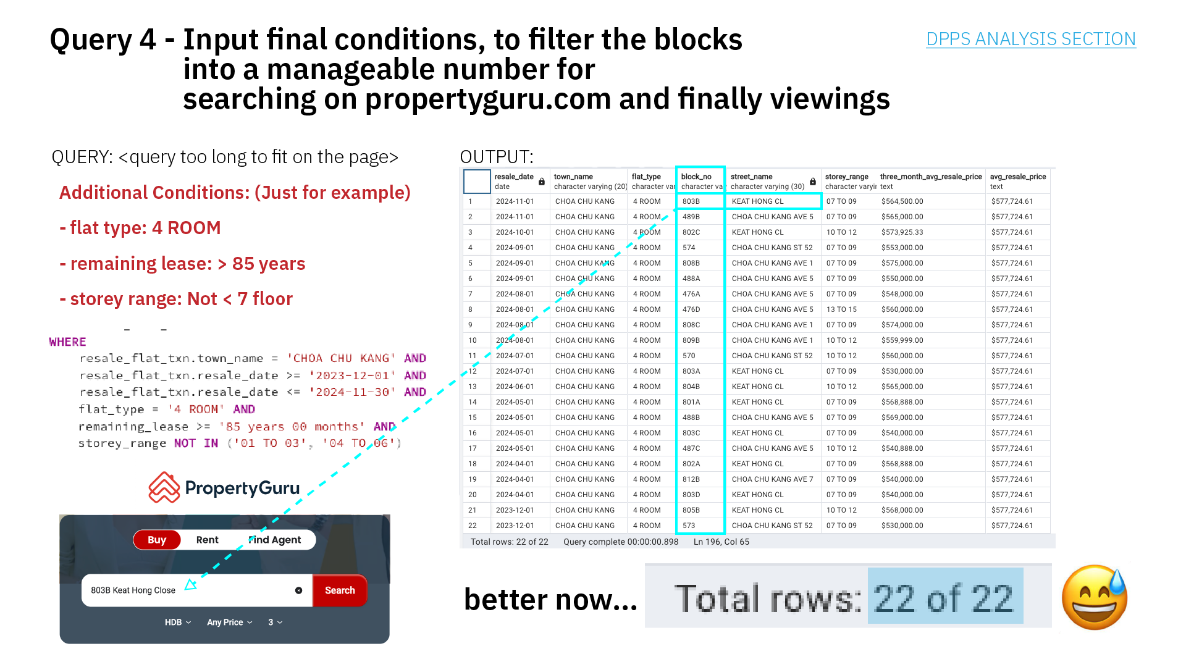


Slide 21
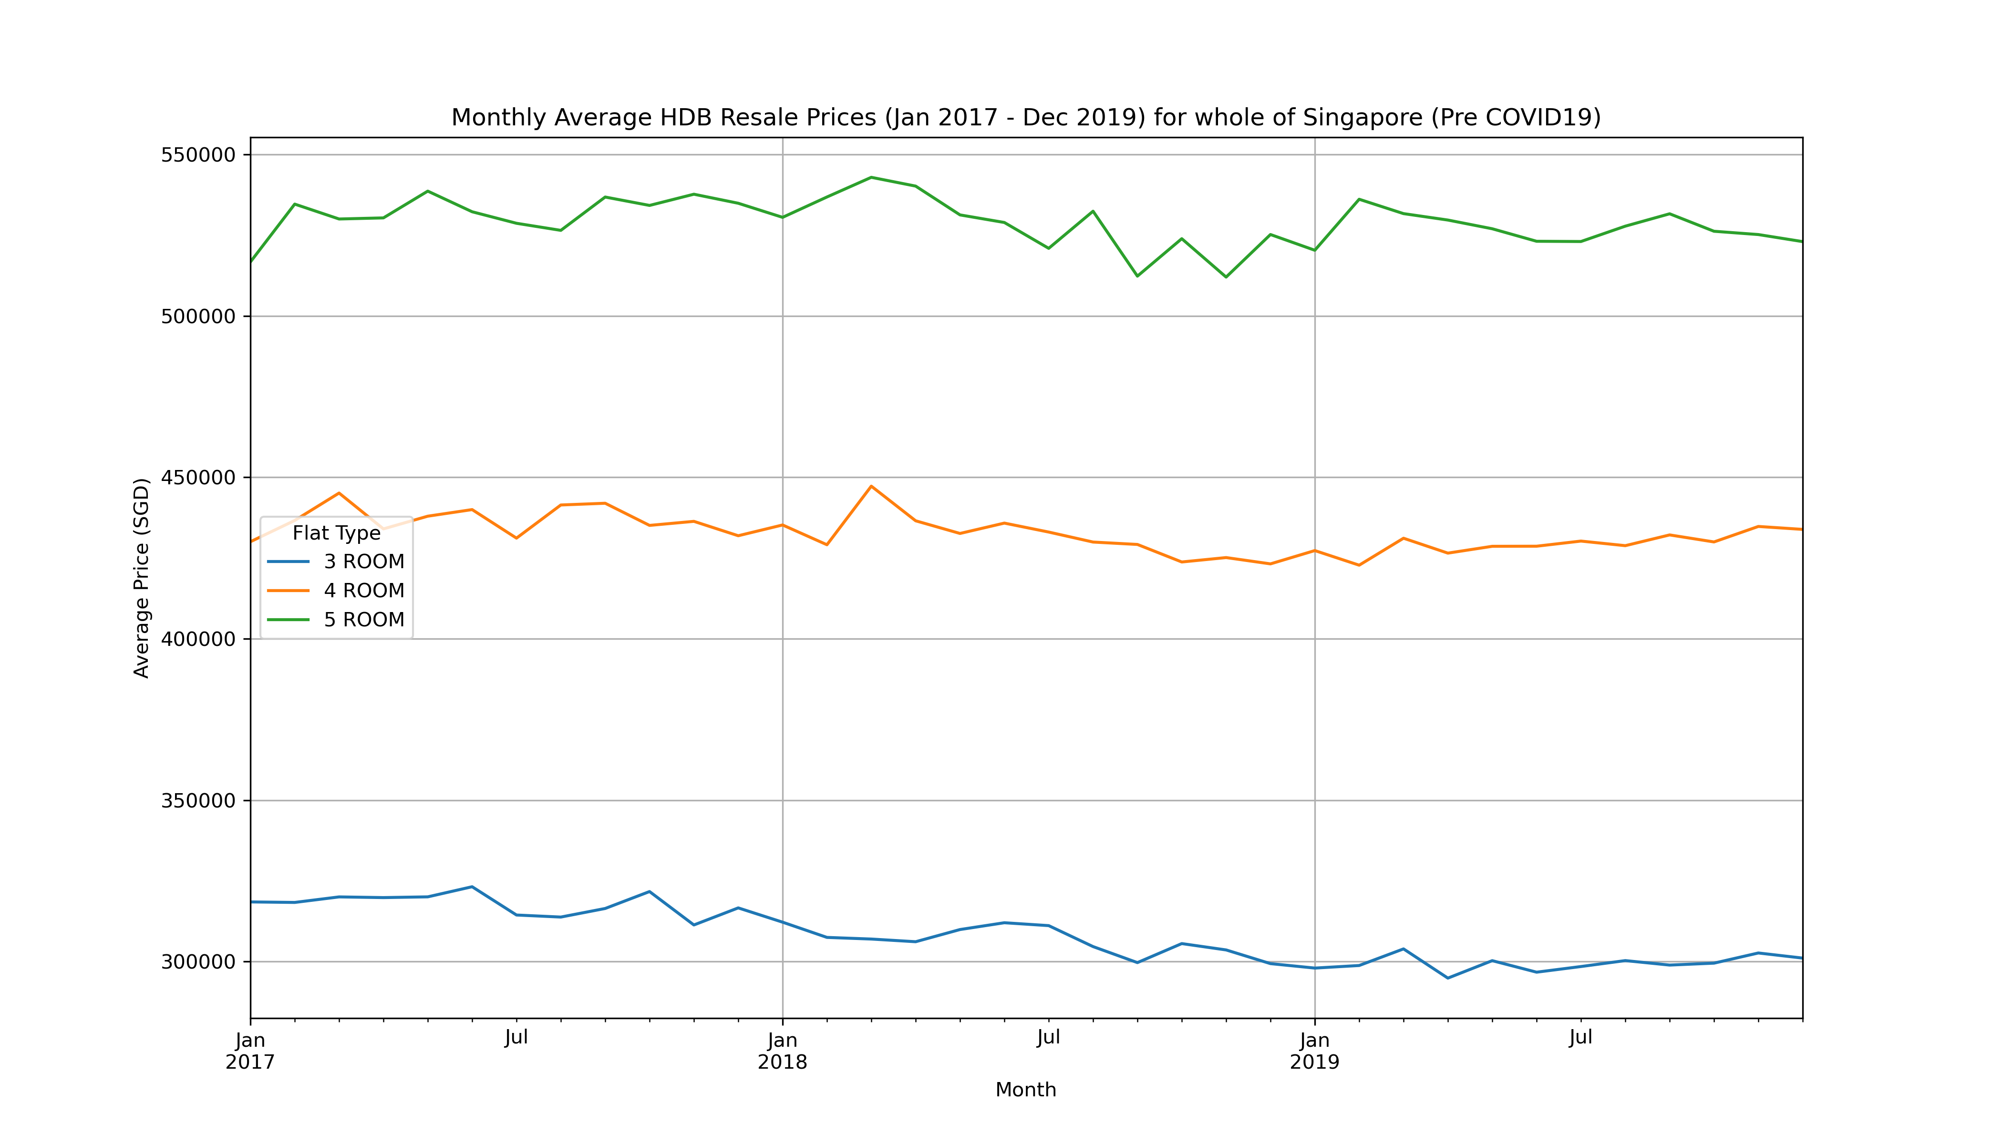
Did COVID19 affect resale prices?

Slide 22
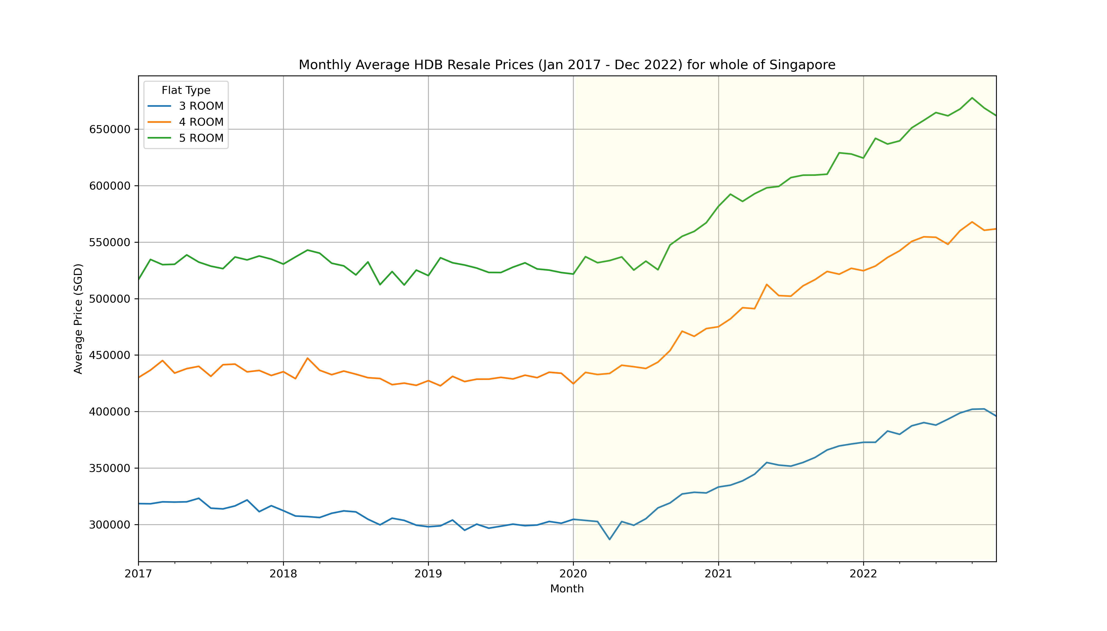
Is it possible to find out? Does anyone know?

Slide 23
PLACEHOLDER

Slide 24
PLACEHOLDER

